Slide 1

Date:- 15/11/2021
Project Title | P75- Summary Extraction along with sentiment analysis.
Team Members | Manan Malhotra
 | Nandini Reddy
 | Renu Rawat
 | Rohit Pawar
 | Shubham Patel
Project Guide | Mr. Parth Sagar

Slide 2
Business Problem:
Business Objective : P75- Summary Extraction along with sentiment analysis.
Objective:
To extract E-books of your choice and extract summary, categorize summary as positive, negative or neutral. Build a NLP model to achieve the said objective with accepted accuracy of 75% and above.

Slide 3

Project Architecture/Project Flow
Business Problem
Data Collection
EDA
Model Building
Data Pre-Porcessing
Model Evaluation
Model Development

Slide 4
Exploratory Data Analysis
Why EDA ?
Exploratory Data Analysis refers to the critical process of performing initial investigations on data so as to discover patterns, to spot anomalies, to test hypothesis and to check assumptions with the help of summary statistics and graphical representations.

Slide 5
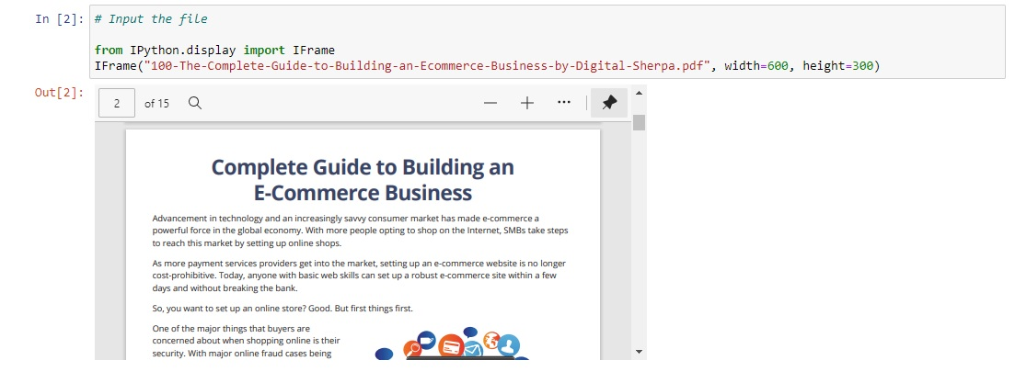
DATA SET

Slide 6
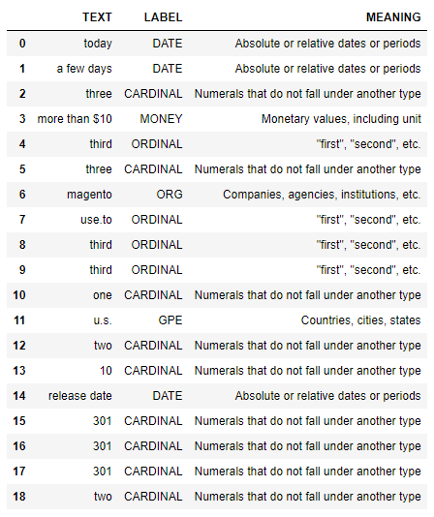
NAMED ENTITY RECOGNITION

Slide 7
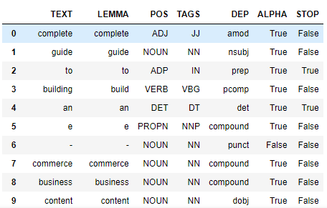
Parts of Speech & Dependency

Slide 8
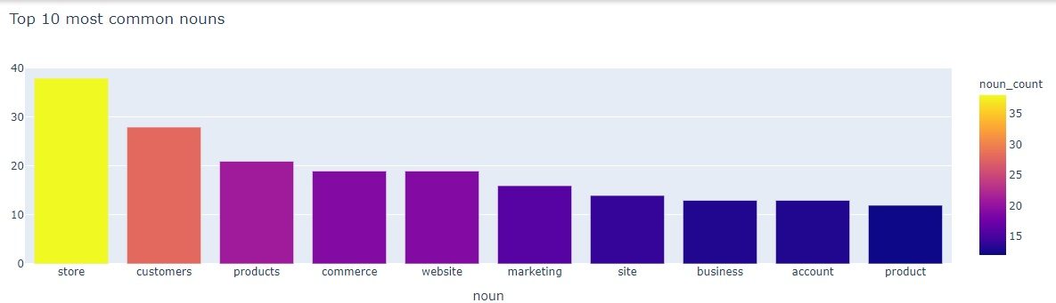
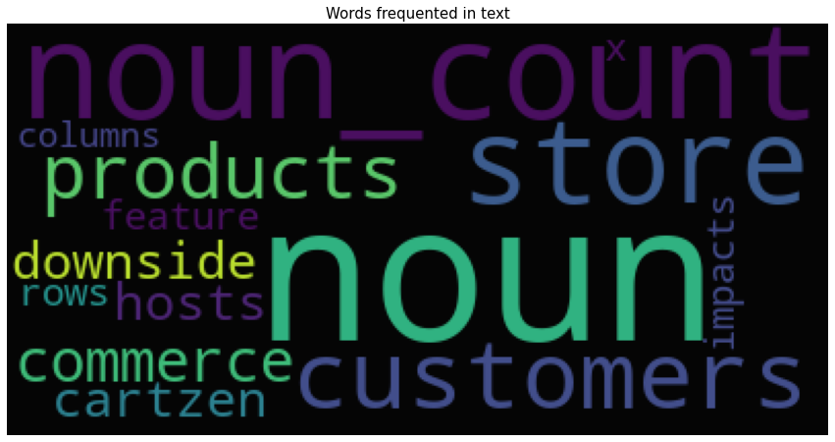
Noun Extraction

Slide 9
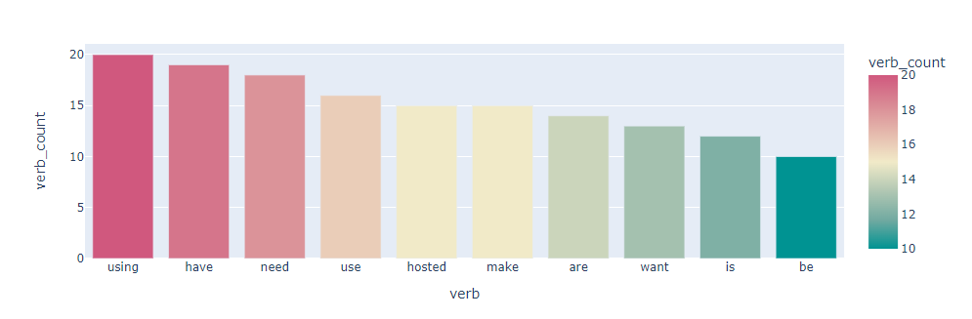
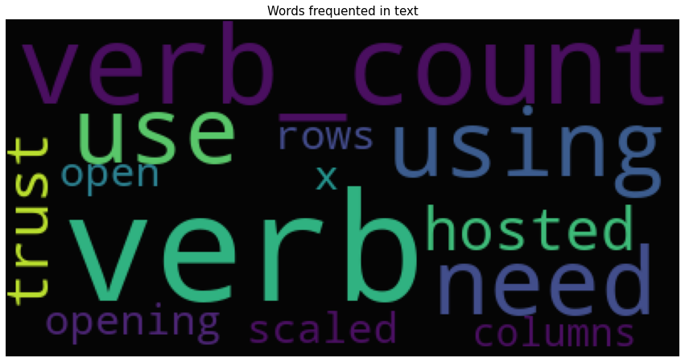
Verb Extraction

Slide 10
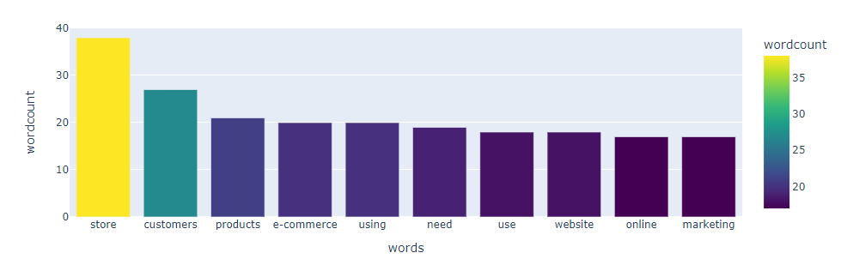
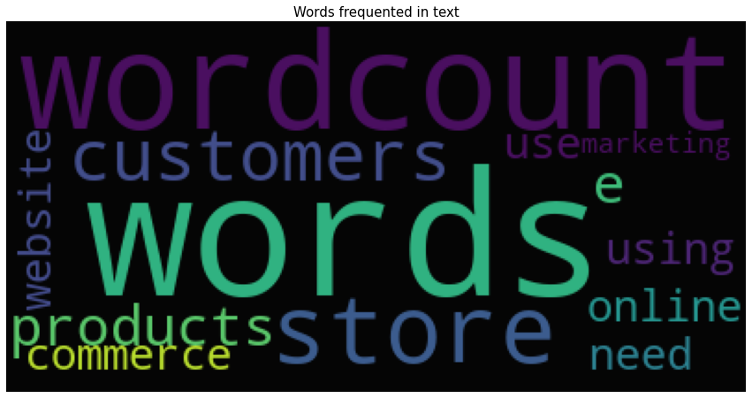
WORD COUNT

Slide 11
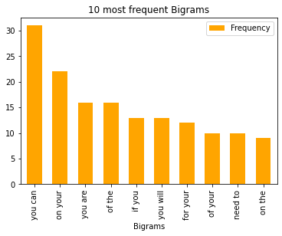
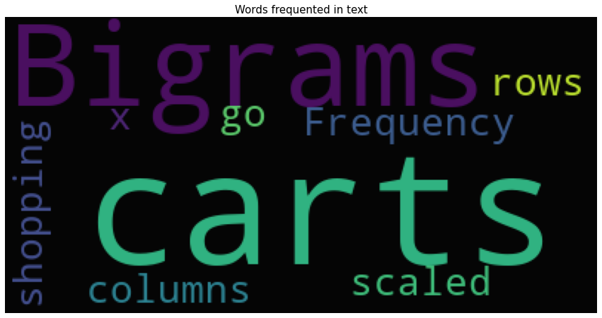
Bigrams

Slide 12
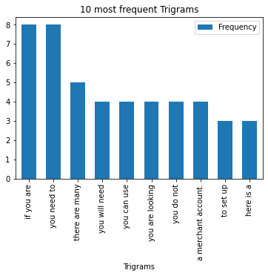
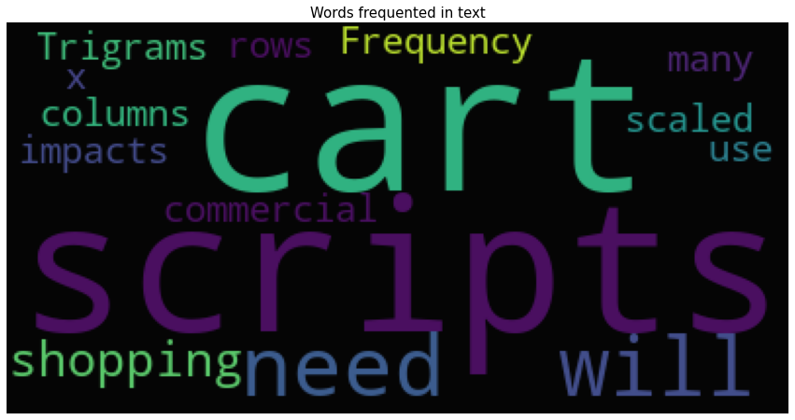
Trigrams

Slide 13
Model Building

Slide 14
Template for Model results presentation
Pre Trained Models
Data set details
Ecommerce_Business_Guide.pdf
Data Partition details
Corpus
Algorithm details and configuration
Sumy summarizers and Gensim summarizer for Extractive
Transformer summarizers for Abstractive
Trained Models
Spacy- Word Frequency
TF-IDF– Math Functions & NLTK
BOW – Count Vectorizer – Sklearn
TF IDF Vectorizer – Sklearn

Slide 15
Model Results
Model generated the output for ebook that was summarized within 5 sentences using different pre-defined summarizers which were abstractive and extractive. Modules that were imported were sumy and transformer.
After that we trained our models using Spacy-word frequency, TF-IDF– Math Functions & NLTK, BOW– Count Vectorizer and TF-IDF Vectorizer and were able to generate the summary from our E-book.
Sentiment Analysis was done on the summaries generated by each model.

Slide 16
Types of Pre Trained Summarizers Used
LexRank Summarizer
Luhn Summarizer
LSA Summarizer
TextRank Summarizer
Edmundson Summarizer
Reduction Summarizer
Gensim Summarizer
T5 Summarizer

Slide 17
LexRank Summarizer
LexRank is an unsupervised approach that gets its inspiration from the same ideas behind Google’s PageRank algorithm. The authors say it is “based on the concept of eigenvector centrality in a graph representation of sentences”, using “a connectivity matrix based on on intra-sentence cosine similarity.” Ok, so in a nutshell, it finds the relative importance of all words in a document and selects the sentences which contain the most of those high-scoring words.

Slide 18
Luhn Summarizer
One of the first text summarization algorithms was published in 1958 by Hans Peter Luhn, working at IBM research. Luhn’s algorithm is a naive approach based on TF-IDF and looking at the “window size” of non-important words between words of high importance. It also assigns higher weights to sentences occurring near the beginning of a document.

Slide 19
LSA Summarizer
Latent Semantic Analysis is a relatively new algorithm which combines term frequency with singular value decomposition.

Slide 20
TextRank Summarizer
TextRank is another text summarizer based on the ideas of PageRank, and was also developed at the same time as LexRank, though by different groups of people. TextRank is a bit more simplistic than LexRank; although both algorithms are very similar, LexRank applies a heuristic post-processing step to remove sentences with highly duplicitous.

Slide 21
Edmundson Summarizer
In 1969, Harold Edmundson developed the summarizer bearing his name. Edmundson’s algorithm was, along with Luhn’s, one of the seminal text summarization techniques. What sets the Edmundson summarizer apart from the others is that it takes into account “bonus words”, words stated by the user as of high importance; “stigma words”, words of low importance or even negative importance; and “stop words”, which are the same as used elsewhere in NLP processing. Edmundson suggested using the words in a document’s title as bonus words. Using the chapter title as bonus words, this is what Edmundson outputs:

Slide 22
Reduction Summarizer
The Reduction algorithm is another graph-based model which values sentences according to the sum of the weights of their edges to other sentences in the document. This weight is computed in the same way as it is in the TexRank model.

Slide 23
T5 Summarizer
T5 or Text-to-Text Transfer Transformer is a model from Google that is trained in an end-to-end manner with text as input and modified text as output. T5 is an abstractive summarization algorithm. It means that it will rewrite sentences when necessary than just picking up sentences directly from the original text.

Slide 24
Types of Trained Models for Summarization Used
Spacy- word frequency
TF-IDF – Math Functions & NLTK
BOW – Count Vectorizer – Sklearn
TF-IDF Vectorizer – Sklearn

Slide 25
Extractive Summarization - TF-IDF
TF-IDF (term frequency-inverse document frequency) is a statistical measure that evaluates how relevant a word is to a document in a collection of documents.
It is done by multiplying two metrics: how many times a word appears in a document, and the inverse document frequency of the word across a set of documents.
It has many uses, most importantly in automated text analysis, and is very useful for scoring words in machine learning algorithms for Natural Language Processing (NLP).

Slide 26
Extractive Summarization – Using Spacy - word frequency
Input Text
Text Cleaning & Preprocessing
Word Tokenization
Sentence Scanning
Word Frequency Table
Generate Summary
Summary

Slide 27
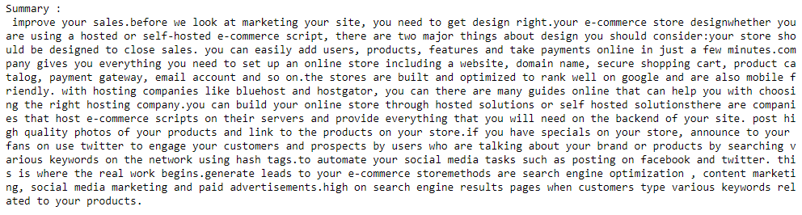
Summary Generated

Slide 28
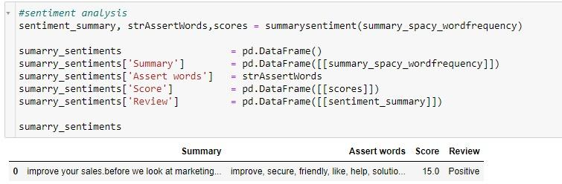
Sentiment Analysis

Slide 29
TF-IDF Math Functions and NLTK
Input Corpus
Tokenize Sentence
Create Frequency Matrix of word in each sentence
Sentence Score =
Sum of TF-IDF score of all words in sentence / Total number of words in sentence
Create TF-IDF Score Of Words in each sentence
Calculate Threshold = Average of sentence score
Generate Summary select sentence score > Threshold
Summary

Slide 30
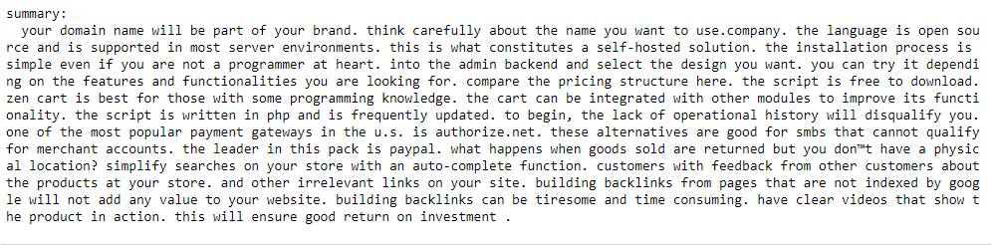
Summary Generated

Slide 31
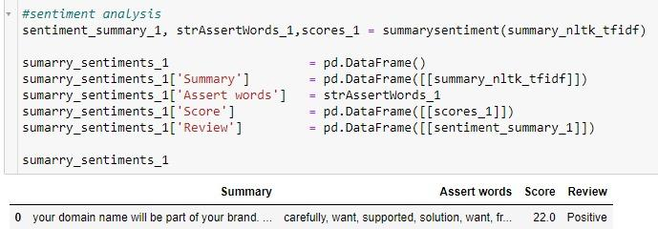
Sentiment Analysis

Slide 32
BOW Count Vectorizer - Sklearn
Input Corpus
Tokenize Sentence
Count Vectorizer
Select Top 5 Sentence Score
Sum BOW Scores
Summary

Slide 33
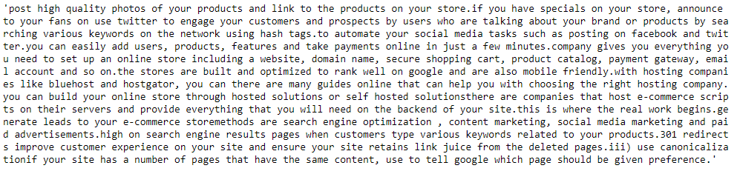
Summary Generated

Slide 34
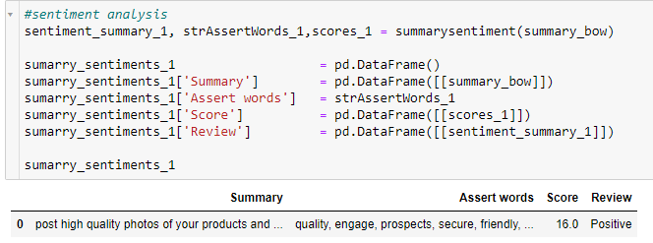
Sentiment Analysis

Slide 35
TF-IDF Vectorizer - Sklearn
Input Corpus
Tokenize Sentence
TF-IDF Vectorizer
Select Top 5 Sentence Score
Sum TF-IDF Scores
Summary

Slide 36
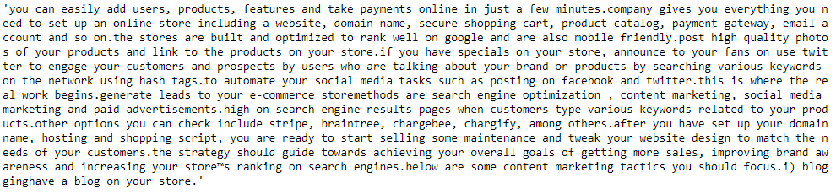
Summary Generated

Slide 37
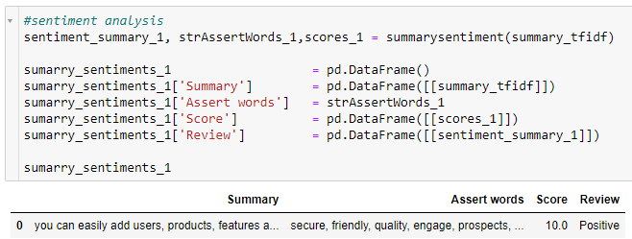
Sentiment Analysis

Slide 38
Model Evaluation – Using Rouge Score
Model Summery | Reference Summery (automatic summarization) | Rang 1 {RP F(%)} | Rang 2 {PLP F(%)} | Rang L {PRP F(%)}
Word Frequency-Spacy. | Reduction Summarizer Edmondson Summarizer | 100/100/99 88/88/88 | 98/98/98 80/85/83 | 100/100/99 87/87/87
BOW – Contrectorizer / Sklearn | Reduction Summarizer Edmondson Summarizer | 89/87/88 77/76/77 | 82/83/83 66/70/68 | 89/87/88 77/75/76
TF-IDF Vectorizer –Sklearn | Reduction Summarizer Edmondson Summarizer | 73/74/74 61/62/62 | 62/68/65 47/54/50 | 73/74/74 61/62/61

Slide 39
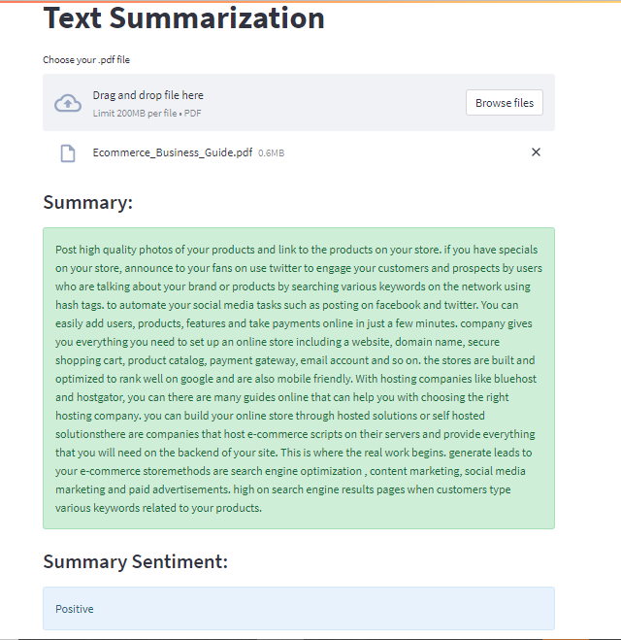
Model Deployment using Streamlit & Github

Slide 40
Feedback
Challenges faced?
For evaluation of Tf-Idf vectorizer model we were not getting any reference summary for the E-book
Accuracy for Tf-Idf vectorizer model was coming below 75%
How did you overcome?
We used summaries generated from the automatic summarizer as reference summary
Instead of unigrams we used bigrams in Tf-Idf vectorizer and the accuracy improved to 89%

Slide 41
Thank you

